Slide 1
Imaging: Strategies and Hands-On
Themiya Nanayakkara
JWST MASTER CLASS MELBOURNE 2022

Slide 2
Introduction
In preparation for the Imaging hands-on exercise, in these slides we go over general imaging observing strategies, including:
Readout modes selection.
Subarrays usage.
Target acquisition.
Dithers and mosaics.
Background strategies.
The focus of the hands-on exercise will be MIRI and NIRCam, but here we review NIRISS as well. NIRISS imaging is only offered in parallel with NIRCam imaging.

Slide 3
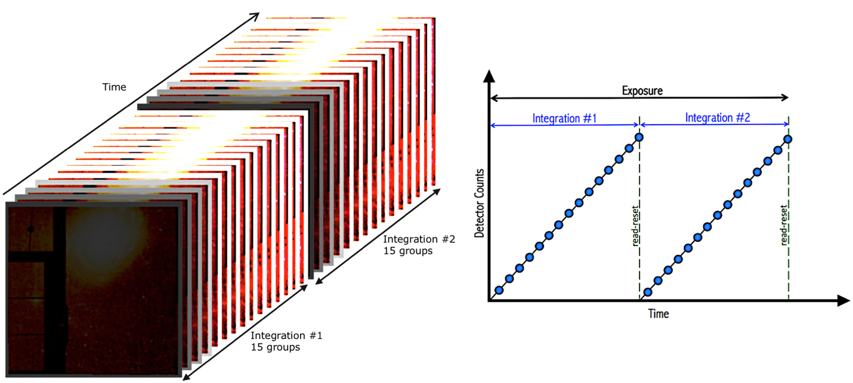
Readout modes: MIRI
READOUT Mode | Group Time | Used in | Recommended for
FAST | 2.775 (in FULL array) | FULL and subarray | All MIRI imaging prime observations
SLOW | 23.889 | Full array only | Parallel observations to reduce data volume
FAST mode offers finer time sampling. Compared to SLOW mode, 9x less time loss in case of a cosmic ray hit.
SLOW mode provides ~9x less data volume

Slide 4
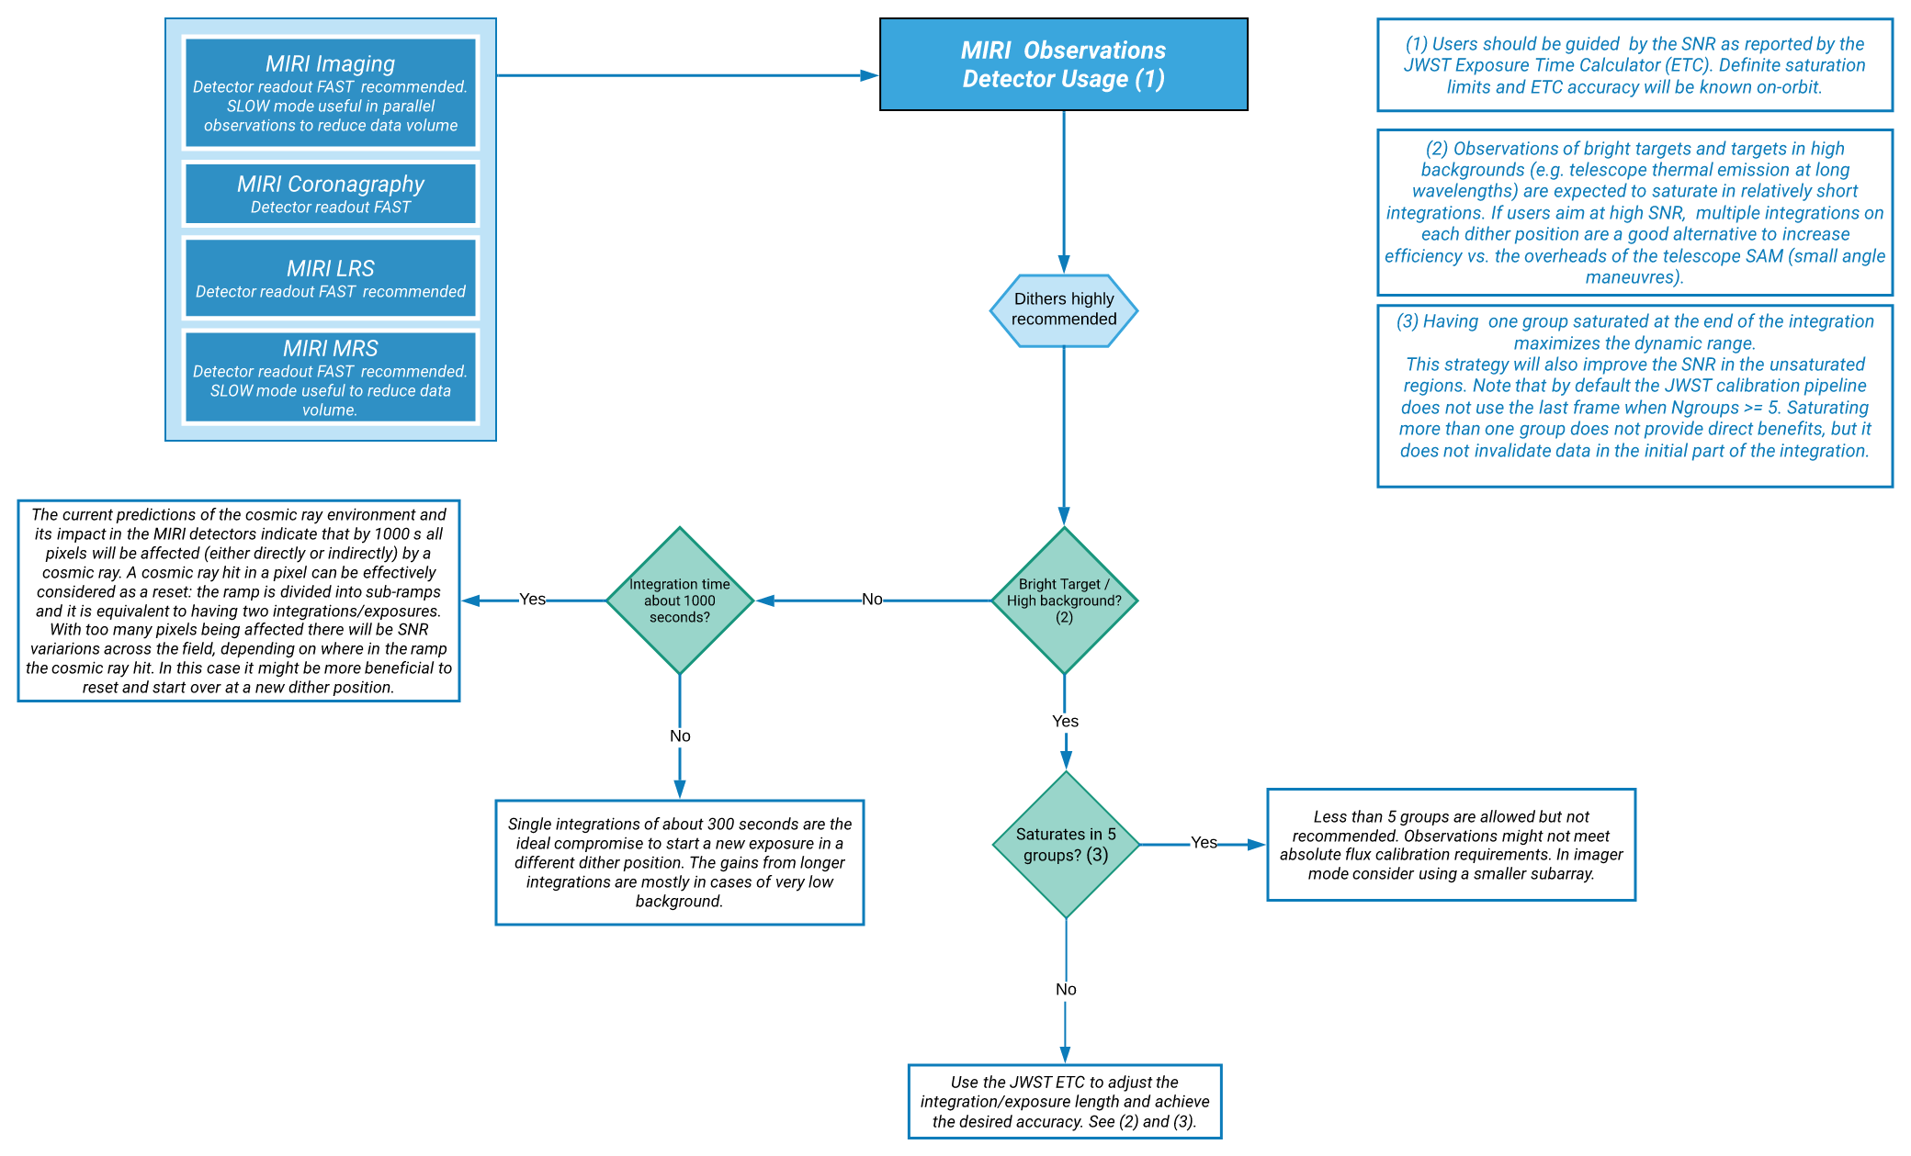
Readout modes: MIRI
How many groups and integrations?
Jdox MIRI detector Usage Reccommendations

Slide 5
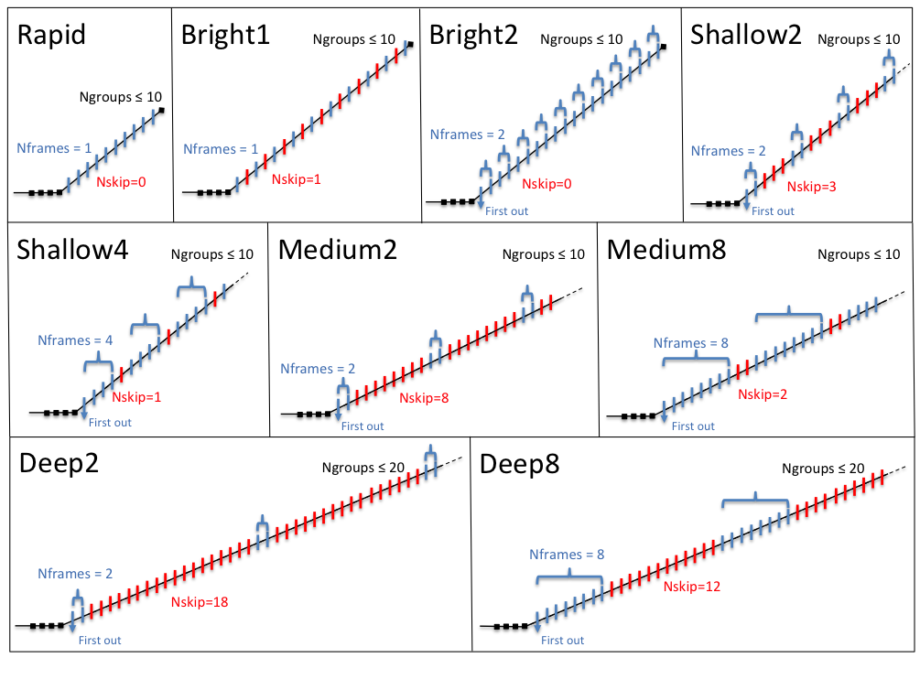
Readout modes: NIRCam
NIRCam offers 9 different readout modes. This combination of readout modes and subarrays (see next section) provides a broad variety of group times (e.g. ~86 s to 0.1 s)
Which readout mode? Names are indicative of the use cases, but users should be guided by the science case, ETC results and spatial coverage to choose a readout mode.
Note the limitations in #groups (data volume)

Slide 6
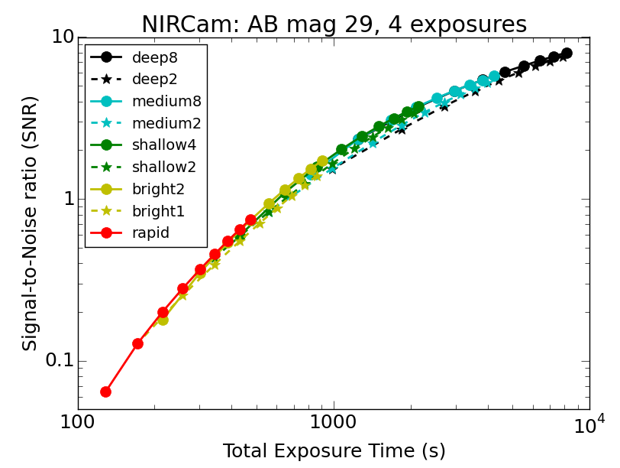
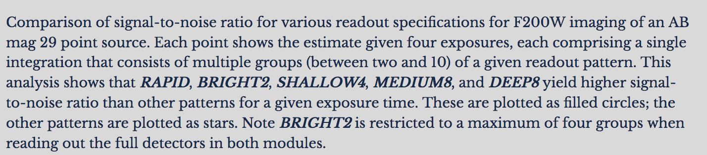
Readout modes: NIRCam
See more information in JDox

Slide 7
Readout modes: NIRCam
How do I do this? Basic guideline
RAPID, BRIGHT2, SHALLOW4, and MEDIUM8 maximize signal-to-noise for a given integration time < 1000 seconds.
More groups are preferred to mitigate cosmic rays for all pixels: e.g. 8 groups of SHALLOW4 rather than 4 groups of MEDIUM8. The minimum number should be 5 groups (although shorter allowed).
1 integration at each dither position will be sufficient for most programs.
If you want to know more here is a detailed report (warning: old cosmic ray model)

Slide 8
Readout modes: NIRISS
READOUT Mode | Group Time | Used in | Recommended for
NISRAPID | 21.474 s | FULL array in imaging(*) | Bright targets, small #ints and no data volume issues. best sampling is obtained in the parallel observations. Limit to about 25 groups
NIS | 53.684 s | FULL array in imaging | Individual exposures longer than about 300 seconds. Limit of 30 groups
(*) NIRISS imaging only uses FULL array mode. Exposure time ”limited” by NIRCam, the prime instrument.

Slide 9
Subarrays Usage
In subarray only a portion of the detector is read out:
Readout time is reduced, enabling rapid observations of bright objects without saturation.
Data volume is reduced (most relevant for NIRCam).
To decide which subarray, users should consider the source brightness and size.
Using the ETC in conjunction with APT is key to decide which subarray is most suitable for your source.
Note that NIRISS imaging only uses full array.
Notes:
ETC informs the SNR reached by a certain exposure time. APT helps visualizing the coverage with Aladdin.

Slide 10
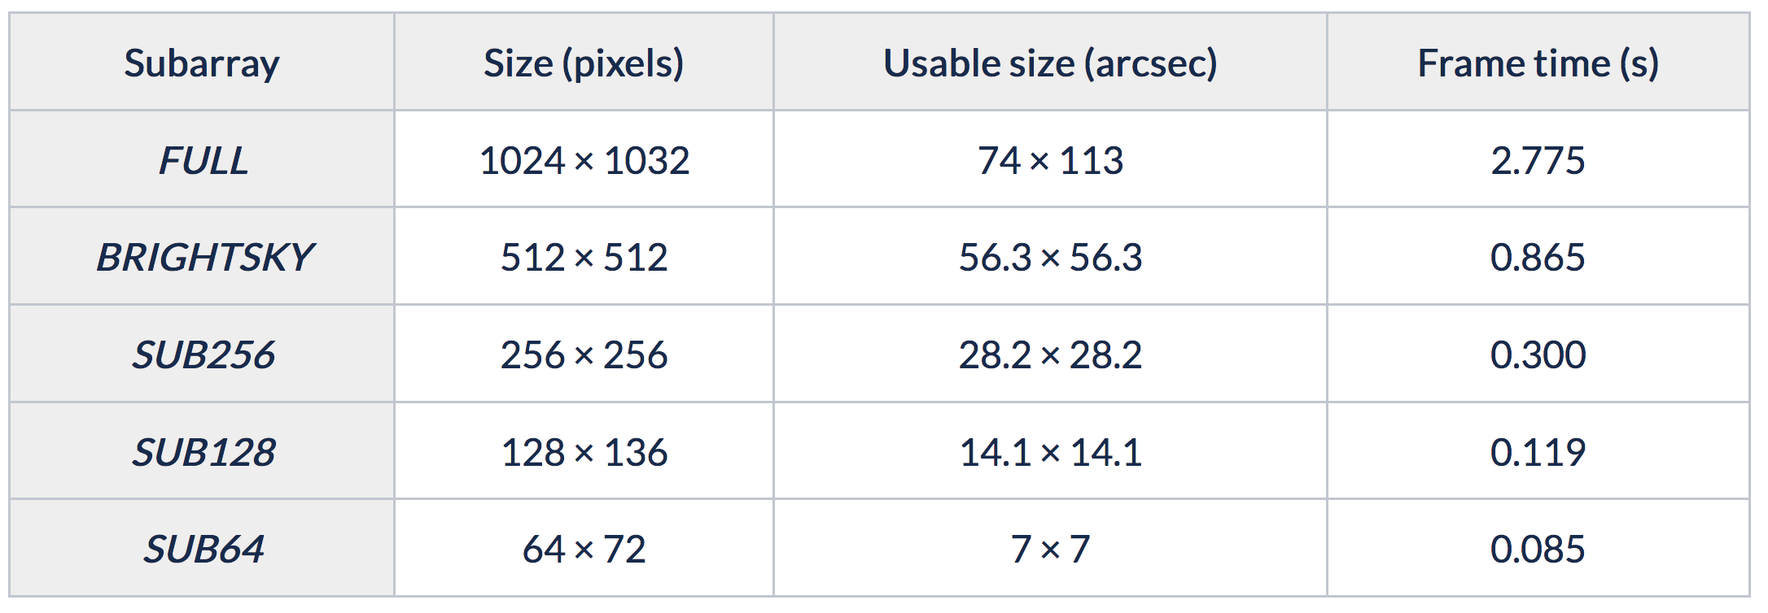
MIRI imaging subarrays
Four different imager subarrays with group times ranging from 0.867 to 0.085 s.
For MIRI use subarrays only if required for bright sources/high backgrounds, not just to image small targets.
SUB128
64
FULL
112.6”
BRIGHTSKY
Remember the group time (i.e. APT and ETC parameters) and frame time is the same for MIRI.
SUB256

Slide 11
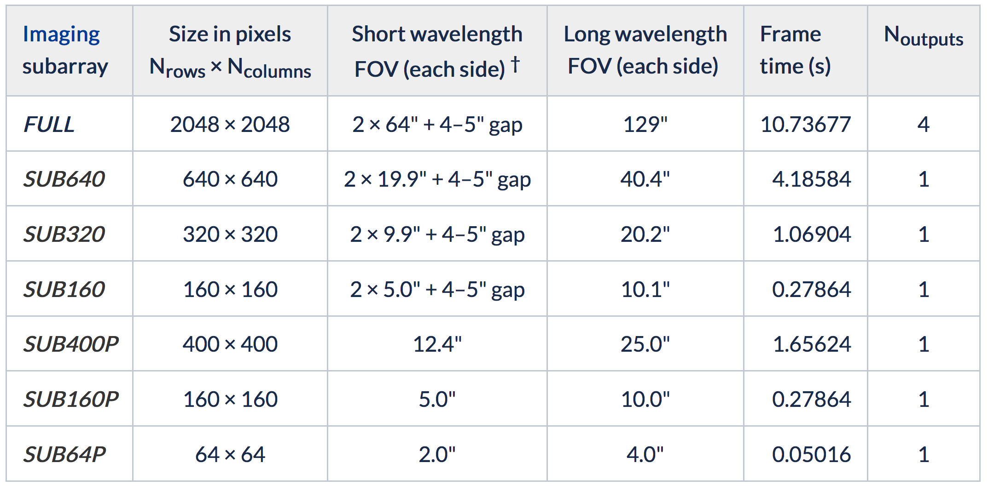
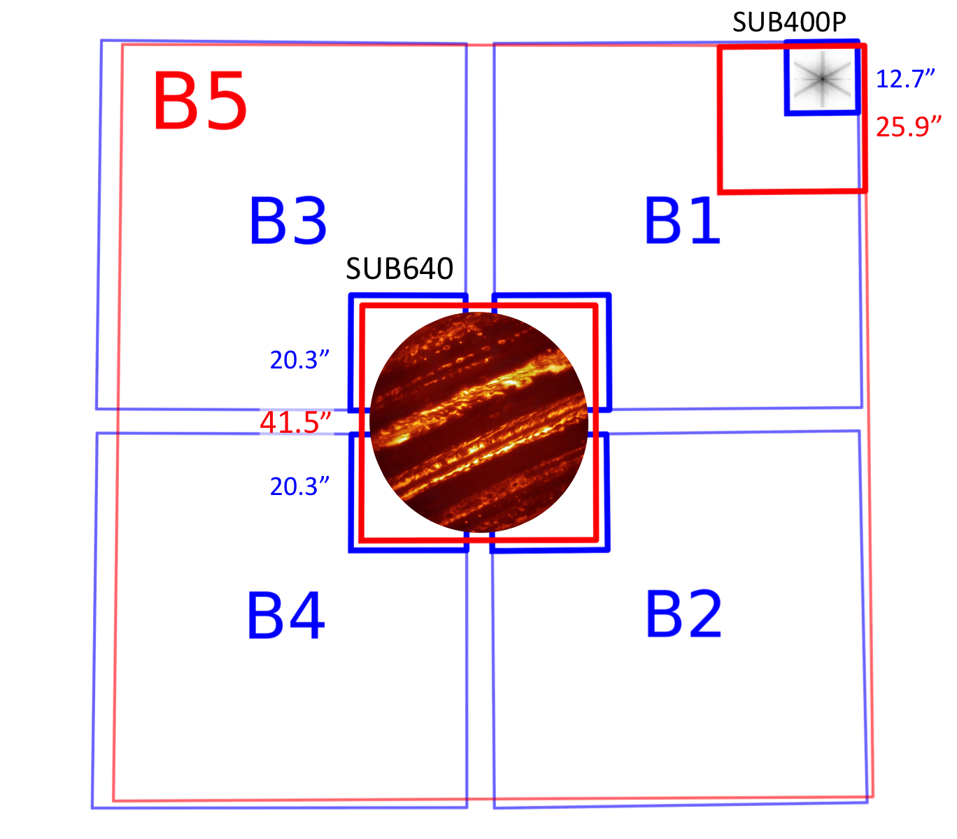
NIRCam imaging subarrays
All defined in module B. Subarrays ending in "P" only use a single detector in the short wavelength channel. The other subarrays are read in all 5 detectors of the module. The resulting images include 4–5" gaps along the center of both axes.
Remember the group time (i.e. APT and ETC parameters) will depend not only on the frame time, but on other detector parameters. It will change with the readout mode.
Notes:
Subarrays ending in "P" only use a single detector in the short wavelength channel. The other subarrays use all four short wavelength detectors; the resulting images include 4–5" gaps along the center of both axes. Note that NIRISS does not offer imager subarrays.

Slide 12
Target acquisition
Is generally not required for imaging observations, as the blind pointing ability of the telescope (0.10” is expected, 1-σ error, per axis ) is sufficiently accurate to center the target in the imager field or subarray. For the special case of high precision photometry of bright sources, TA may be desired.
Imaging TA is currently not supported
MIRI might offer imaging TA in cycle 2 (mostly for the small subarrays).

Slide 13
Dithering
Dithering is highly recommended in all imaging
observations:
It allows good PSF sampling—this is mostly relevant when using the F560W filter in MIRI (Nyquist sampled at longer wavelengths), and for most NIRCam and NIRISS filters.
It minimizes detector cosmetics and defects
It makes possible accurate background measurements for point sources, and at longer (MIRI) wavelengths permits tracking of potential telescope thermal emission variations.
It mitigates the impact of bad pixels.
It allows tracking detector drifts.
In NIRCam larger primary dithers are useful to fill gaps in sky coverage. Smaller subpixel dithers are optimized to improve sampling in stacked images.
Dedicated dithers for NIRCam/NIRISS parallel observations.

Slide 14
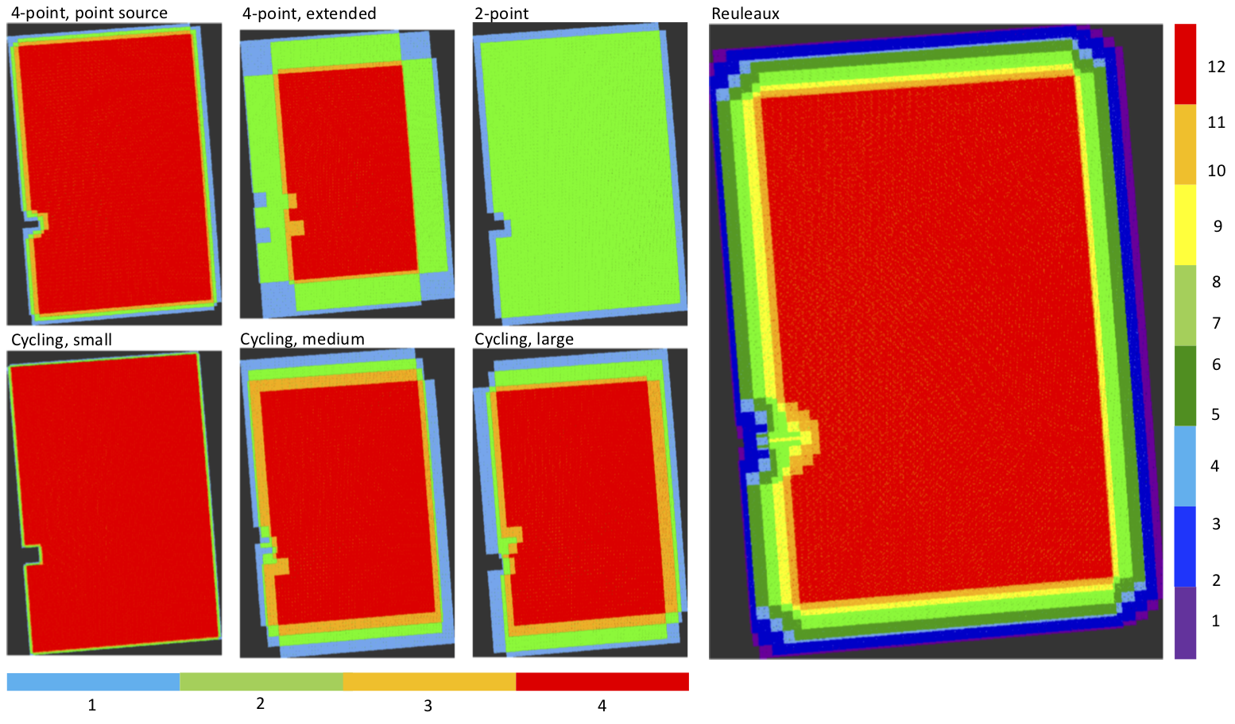
Dithering
Example coverage of several MIRI imaging dithers

Slide 15
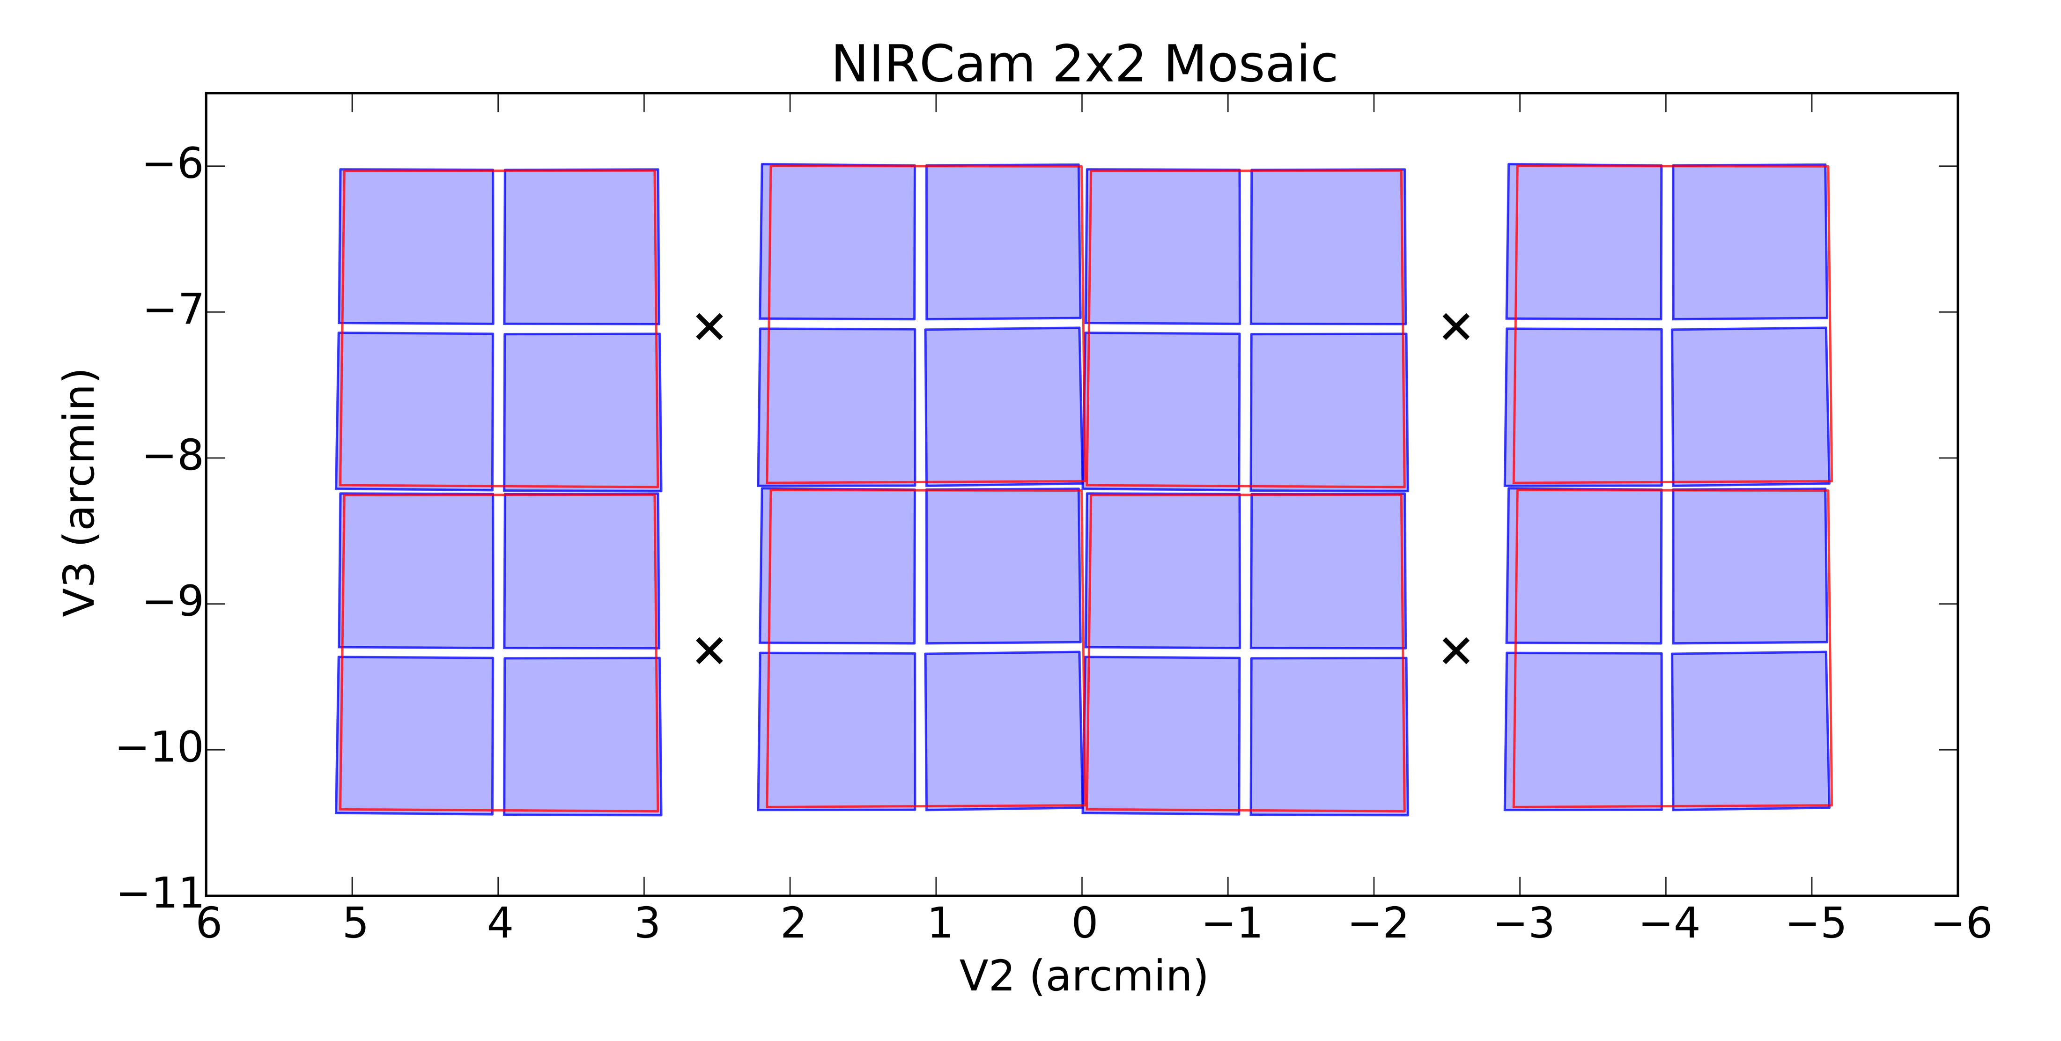
Mosaics
Used to cover areas larger than the nominal FOV: 5.1' × 2.2' NIRCam and 1.8’x1.2’ for MIRI.
Depending on the NIRCam module/subarray and overlap, mosaics may have module and detector gaps.
To obtain a roughly even observing depth over large areas, consider using the NIRCam FULL primary dither patterns in conjunction with mosaics with tile spacings of 5.8' × 2.25’.
For MIRI a minimum of 10% overlap is suggested, larger overlaps will facilitate image combinations.
Users are encouraged to use Aladin to verify source placement in different orientations, as well as APT shift rows and columns, to ensure that science requirements are always met

Slide 16
Background
JWST imagers cover a large spectral region, roughly from 0.6 to 28 microns.
For <15 μm, in-field zodiacal background dominates the background.
At longer wavelengths, thermal emission from JWST itself is the dominant source of background. This component only affects MIRI.
The ETC can be used to assess if observations are background limited; the Background Limited special requirement in APT will limit scheduling to when the background is relatively low.

Slide 17
Background observations
Extended sources
(covering entire FOV)
Point sources
As part of a mosaic (Recommended)
No background observations needed. In high background observations, the flat field uncertainty will affect the SNR.
Advised to obtain background data in every spectral configuration used by the science data.
Off-source target
As a ”rule of thumb” the background will change for different observing periods.

Slide 18
Useful JDox links
MIRI
https://jwst-docs.stsci.edu/mid-infrared-instrument/miri-operations/miri-dithering/miri-imaging-dithering
https://jwst-docs.stsci.edu/mid-infrared-instrument/miri-observing-strategies/miri-imaging-recommended-strategies
https://jwst-docs.stsci.edu/mid-infrared-instrument/miri-observing-strategies/miri-cross-mode-recommended-strategies#MIRICross-ModeRecommendedStrategies-MIRIbackgroundBackgroundobservationsrecommendations
https://jwst-docs.stsci.edu/mid-infrared-instrument/miri-instrumentation/miri-detector-overview/miri-detector-subarrays#MIRIDetectorSubarrays-Imaging
https://jwst-docs.stsci.edu/mid-infrared-instrument/miri-operations/miri-target-acquisition/miri-imaging-target-acquisition

Slide 19
Useful JDox links
NIRCam
https://jwst-docs.stsci.edu/near-infrared-camera/nircam-instrumentation/nircam-detector-overview/nircam-detector-readout-patterns
https://jwst-docs.stsci.edu/near-infrared-camera/nircam-observing-strategies/nircam-imaging-recommended-strategies#NIRCamImagingRecommendedStrategies-ditheringDitherpattern
https://jwst-docs.stsci.edu/near-infrared-camera/nircam-instrumentation/nircam-detector-overview/nircam-detector-subarrays
https://jwst-docs.stsci.edu/near-infrared-camera/nircam-operations/nircam-dithers-and-mosaics/nircam-mosaics
https://jwst-docs.stsci.edu/near-infrared-camera/nircam-operations/nircam-dithers-and-mosaics

Slide 20
Useful JDox links
NIRISS
https://jwst-docs.stsci.edu/near-infrared-imager-and-slitless-spectrograph/niriss-instrumentation/niriss-detector-overview/niriss-detector-readout-patterns
https://jwst-docs.stsci.edu/near-infrared-imager-and-slitless-spectrograph/niriss-operations/niriss-dithers/niriss-imaging-dithers
https://jwst-docs.stsci.edu/near-infrared-imager-and-slitless-spectrograph/niriss-observing-strategies/niriss-imaging-recommended-strategies

